Slide 1
presented by Amanda, Charity, & Sergio
Project 4

Slide 2
Agenda
Introduction
Data Collection Methods
Transforming/ Cleaning Process
Model
Visualizations

Slide 3
Data
For this project, a database for heart disease was pulled from a UC Irvine Machine Learning Repository.
Project Description
The primary objective is to utilize machine learning models on a dataset of patient information to predict whether a person has heart disease.

Slide 4

Extraction/Data Collection

Slide 5
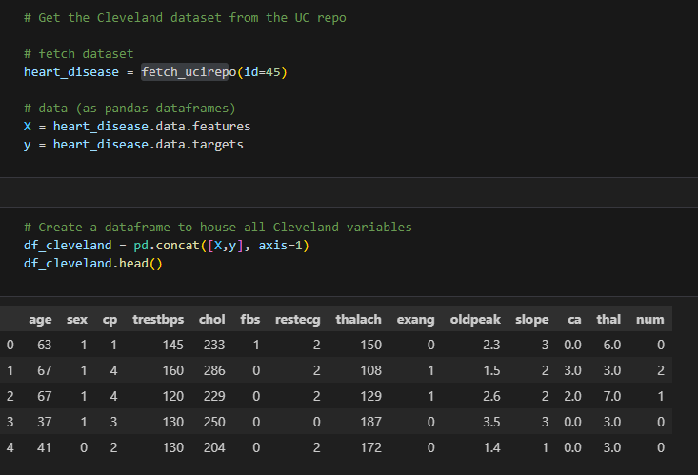
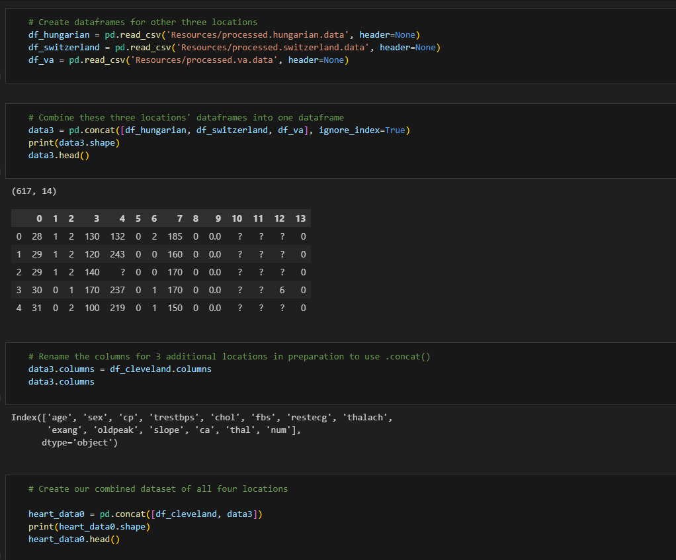
Fetching data from UC repo
We Began by grabbing our first dataset from the provided Repo.
Only Data from Cleveland was provided in the repo
2.) Fetching remaining data sets
The data from the other three locations-- Hungary, Switzerland, and VA Long Beach-- which we downloaded as .data files from the UC repo.
Finally, we will combine the four locations into one dataset.

Slide 6
Transform/Data Cleaning

Slide 7
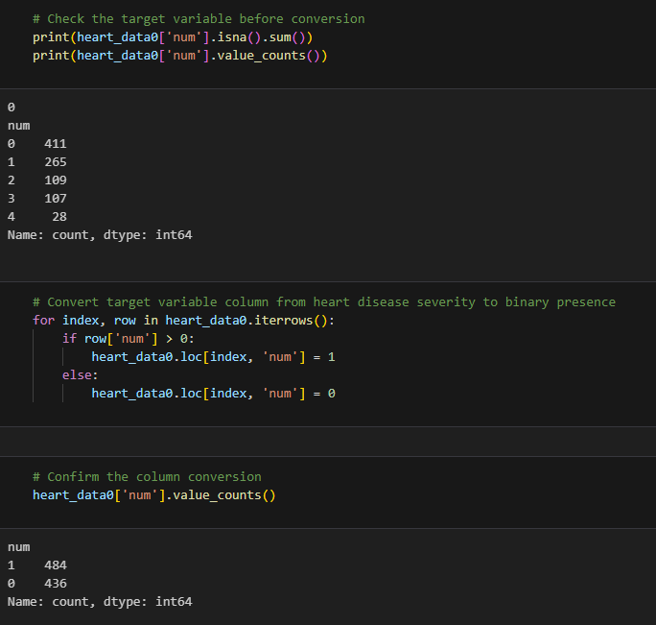
Transforming Data
The dataset contains categorical variables. ‘num’, which indicates the presence and severity of heart disease on a scale of 0 to 4.
For the purpose of our analysis, we will convert this into a binary variable that indicates the presence of heart disease.

Slide 8
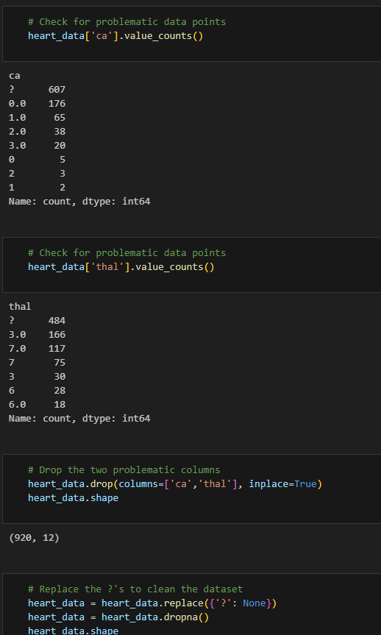
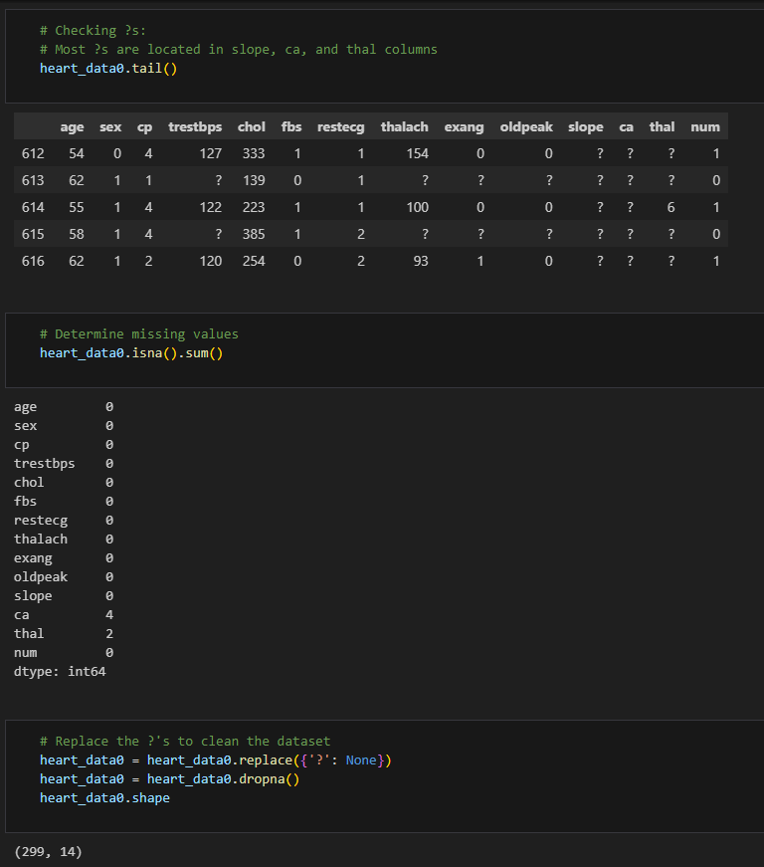
Transforming Data
Many cells contain a “?” As an entry, which is not detected as a missing value, so we will convert cells with ?’s to Na’s then use .dropna()
Our number of observations falls to just 299, which is hardly better than just using the Cleveland dataset which contains no missing values
Instead, we will drop the two most problematic columns, ‘ca’ and ‘thal’, before using the .replace() function, to keep more observation instact.

Slide 9
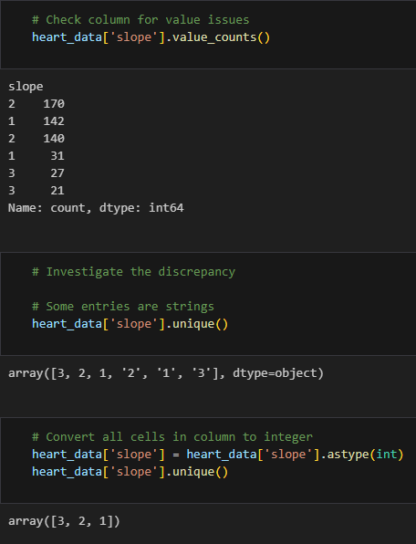
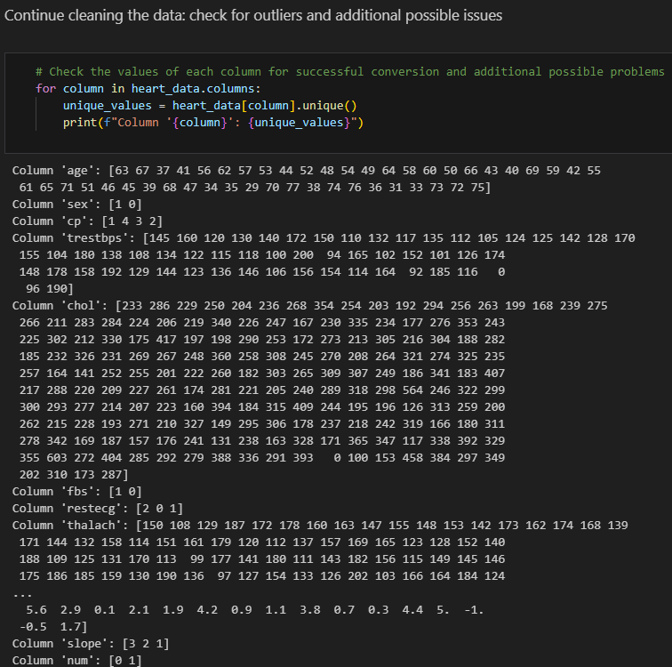
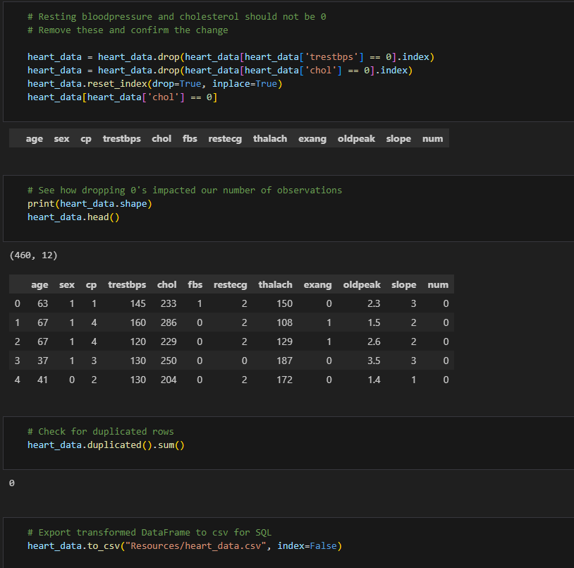
Cleaning Data
Finished cleaning the data by removing cells with identical values that were being read as two separate numbers
checked for outliers and additional possible issues

Slide 10
Logistic Regression Model

Slide 11
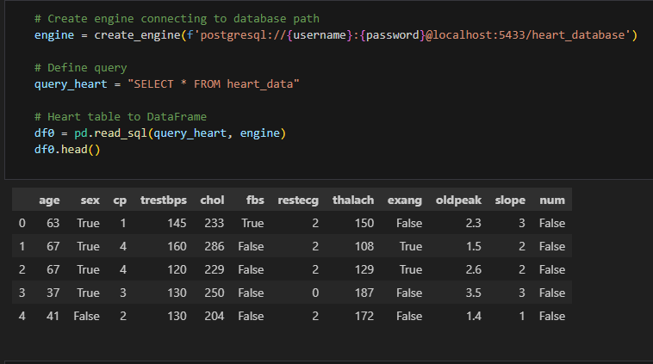
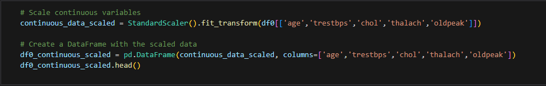
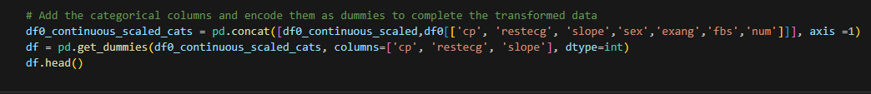
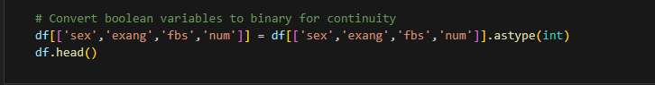
Data Preparation
first, we're connecting to our PostgreSQL database
Then, we scaled continuous variables like age, blood pressure, and cholesterol, putting them into a new table called 'df0_continuous_scaled’.
Next up, we're adding categorical columns and encoding them as dummies to complete our data transformation.
After that, we're converting boolean variables to binary to make them easier to work with.

Slide 12
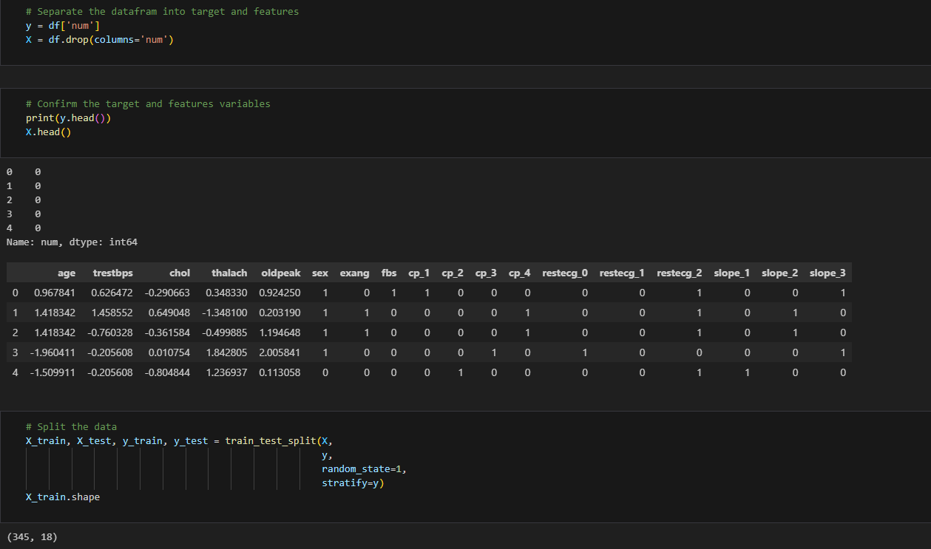
Training and Testing Data
Next, we split our data into two parts: 'y' represents the target variable, and 'X' contains all the other features.
This helps us evaluate how well our model performs on new, unseen data. We use 75% of the data for training and 25% for testing.
Finally, we check the shape of our training set to see how many rows and columns it has. This process sets us up to train our machine learning model on the training data and then test it on the testing data to see how well it works."

Slide 13
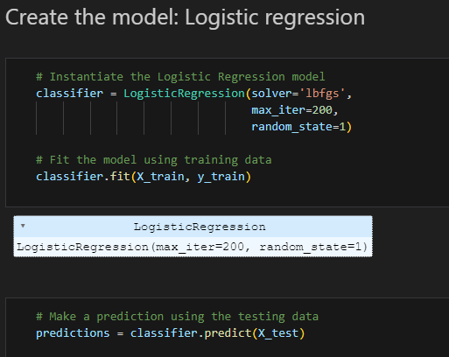
Creating the model
moving into to building our logistic regression model. First, we create the model using the Logistic Regression function, specifying parameters like the solver for optimization, maximum iterations, and setting a random state for reproducibility.
Then, we fit the model using our training data. This means the model learns from the patterns in the data, trying to understand how features relate to the target variable.
After that, we use the model to make predictions on our testing data. The model uses what it learned during training to predict the target variable for the testing data. This way, we can see how well our model performs on new, unseen data."

Slide 14
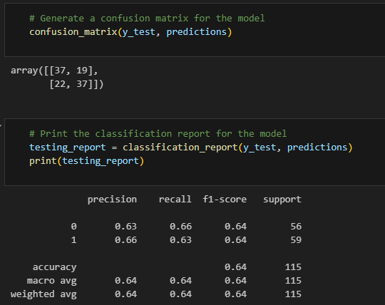
Evaluate the models performance
so now we're evaluating our logistic regression model. We generate a confusion matrix, which shows us how many true positives, true negatives, false positives, and false negatives our model predicted.
Then, we print out a classification report. This report gives us a summary of how well our model performed, including metrics like precision, recall, and F1-score for each class in our target variable.
Together, these help us understand how accurately our model is classifying instances of heart disease in our testing data."

Slide 15
Charity

Slide 16
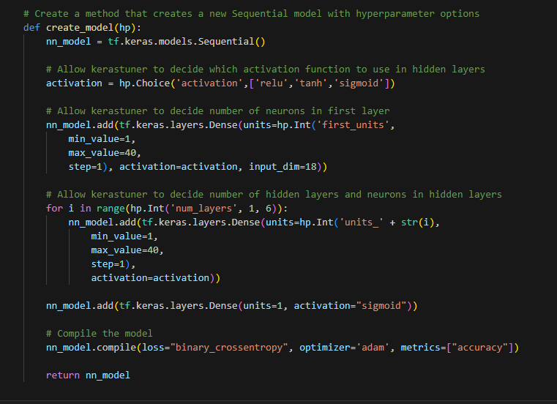
Using Keras Tuner
We start the neural network using TensorFlow and Keras Tuner.
This allows customization of activation functions, the number of neurons in the first layer, and the number of hidden layers and neurons.
Finally, the method compiles the model with binary cross-entropy loss and the Adam optimizer, giving us a flexible way to create and tune neural networks for various tasks.

Slide 17
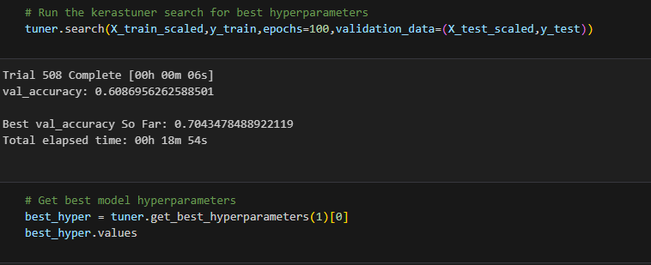
We set to train the model for 100 epochs using the training data X_train_scaled and y_train, while validating it on the test data X_test_scaled and y_test. This process helps optimize the model's performance by exploring different combinations of hyperparameters.

Slide 18
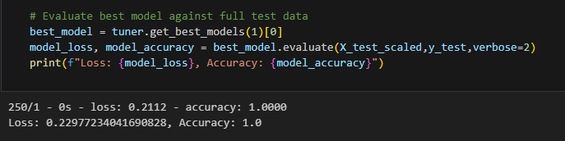
Finally we evaluates the best model found during the hyperparameter search using Keras Tuner against the full test data.
It retrieves the best model from the tuner, evaluates its performance on the scaled test data X_test_scaled and y_test, and prints out the loss and accuracy metrics.
This step helps us understand how well the optimized model performs on unseen data.

Slide 19
Conclusion

